Slide 1








November Meeting Nov 4, 2025
Notes:
claire

Slide 2
FBLA Pledge
I solemnly promise to support the mission of Future Business Leaders of America, abide by its Code of Ethics and Code of Conduct, and develop the qualities necessary to become a community-minded business leader.
Notes:
pranava

Slide 3
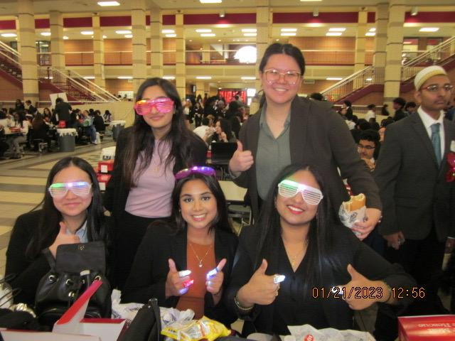
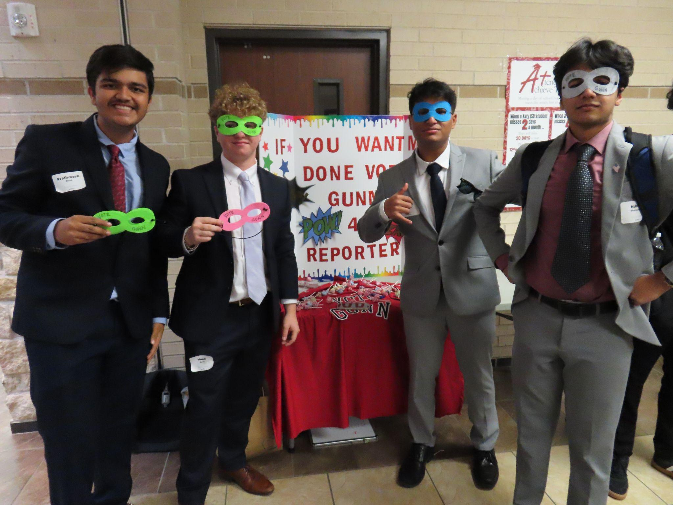
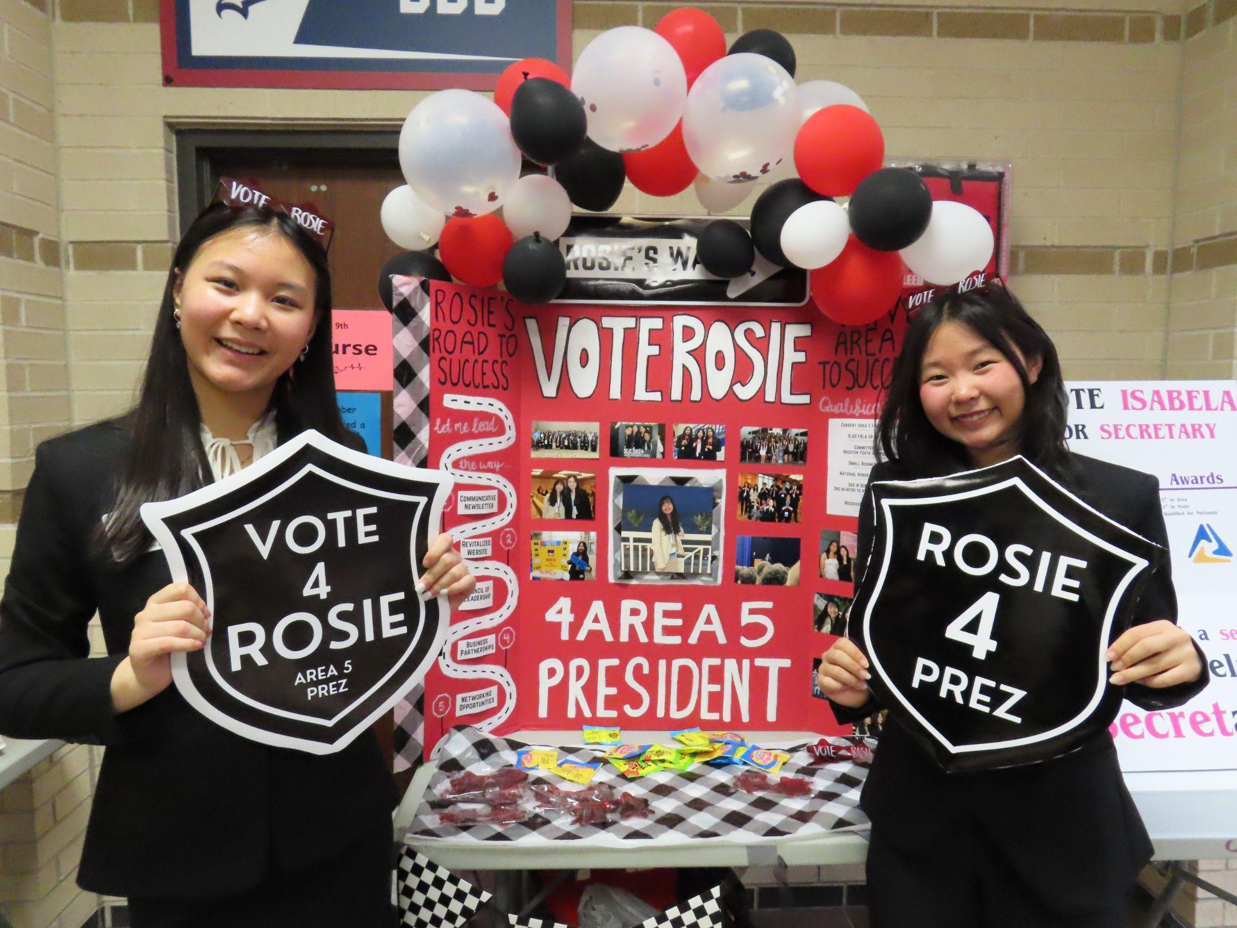
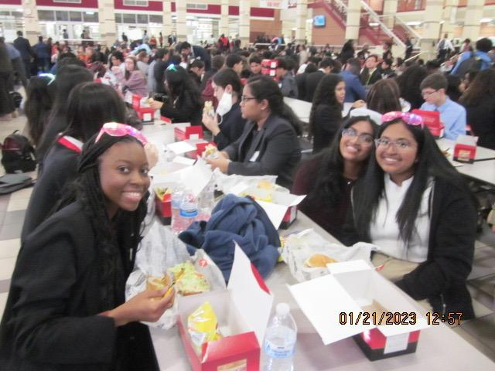
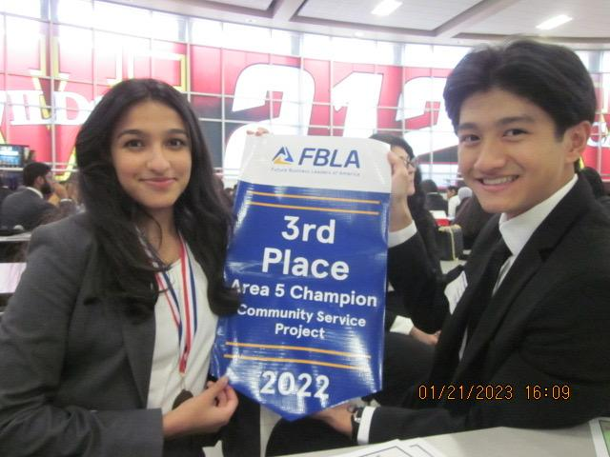
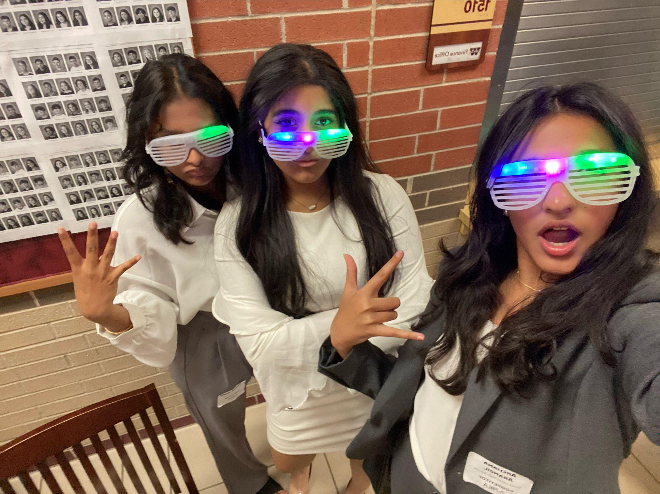
AREA LEADERSHIP CONFERENCE
Notes:
no one

Slide 4
AREA LEADERSHIP CONFERENCE
travel to Mayde Creek High School
December 6th
Arrive in front SLHS
6:20 am
Notes:
sana

Slide 5
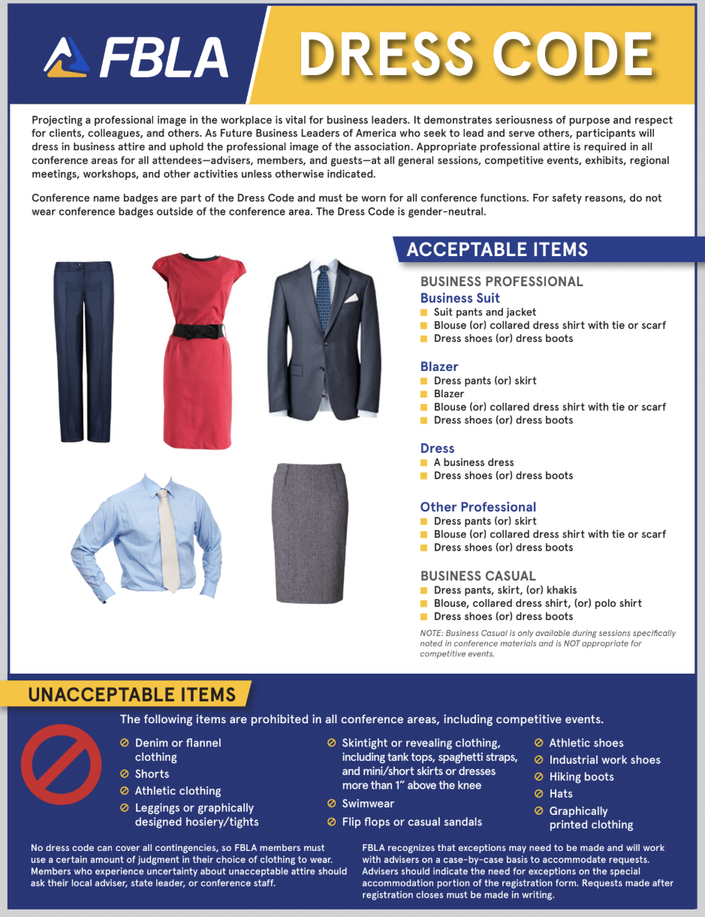
DRESS CODE
FBLA Business Professional wear is required at Area Leadership Conference.
Points may be deducted if you are not dressed properly.
Notes:
titi

Slide 6
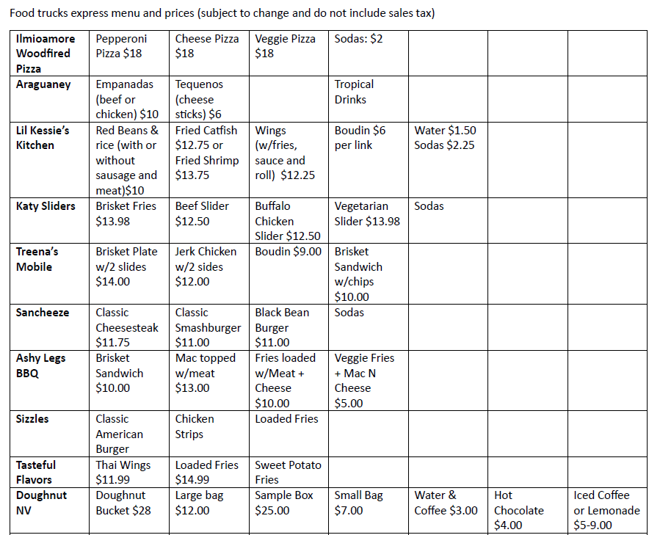
Lunch Food Trucks
11 - 2
Bring money
Notes:
sana

Slide 7
UPCOMING DEADLINES
NOVEMBER 30TH
PROJECT/REPORT SUBMISSION:
Business Ethics (Case Study)
Business Plan (Report)
Community Service Report (Report)
Digital Animation (URL)
Job Interview (Cover Letter)
Job Interview (Resume)
Local Chapter Annual Business Report
EMAIL TO SEVENLAKESFBLA@GMAIL.COM
Notes:
anand

Slide 8
DECEMBER 1ST-3RD
ALL TESTING EVENTS:
DEC 1ST
DEC 2ND
DEC 3RD
Accounting
Advertising
Business Communications
Business Ethics
Business Law
Business Management
Computer Problem Solving
Economics
Entrepreneurship
Human Resource Management
Sports Marketing
Hospitality Management
International Business
Intro to Business Concepts
Intro to FBLA
Intro to Information Tech
Management Information
Marketing
Networking Infrastructure
Organizational Leadership
Parliamentary Procedure
Personal Finance
Project Management
Real Estate
Retail Management
ANY TEST MAKE-UPS
ALL TESTING AFTER SCHOOL IN ROOM 2513 & ROOM 2515
Notes:
claire (valid absences)

Slide 9
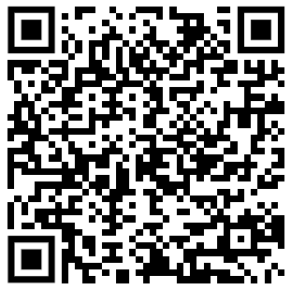
TEST REQUEST
Test Request is REQUIRED for all testing events
Scan the QR Code to request up to 3 practice tests for your event!
Tip: Time yourself while taking the test for the best practice!
Notes:
vig

Slide 10
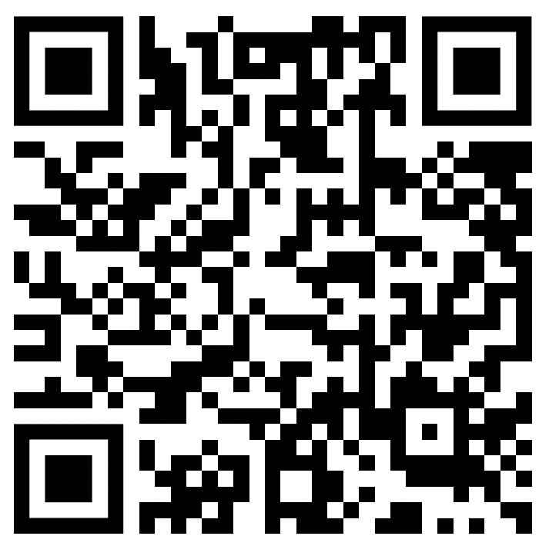
MOCK AREA
MOCK AREA HAS LIMITED SPOTS--SIGN UP QUICK
Present your presentation/role play to FBLA officers and get rubric-based feedback!
Scan the QR Code to schedule a Mock Area!
Notes:
amisha

Slide 11
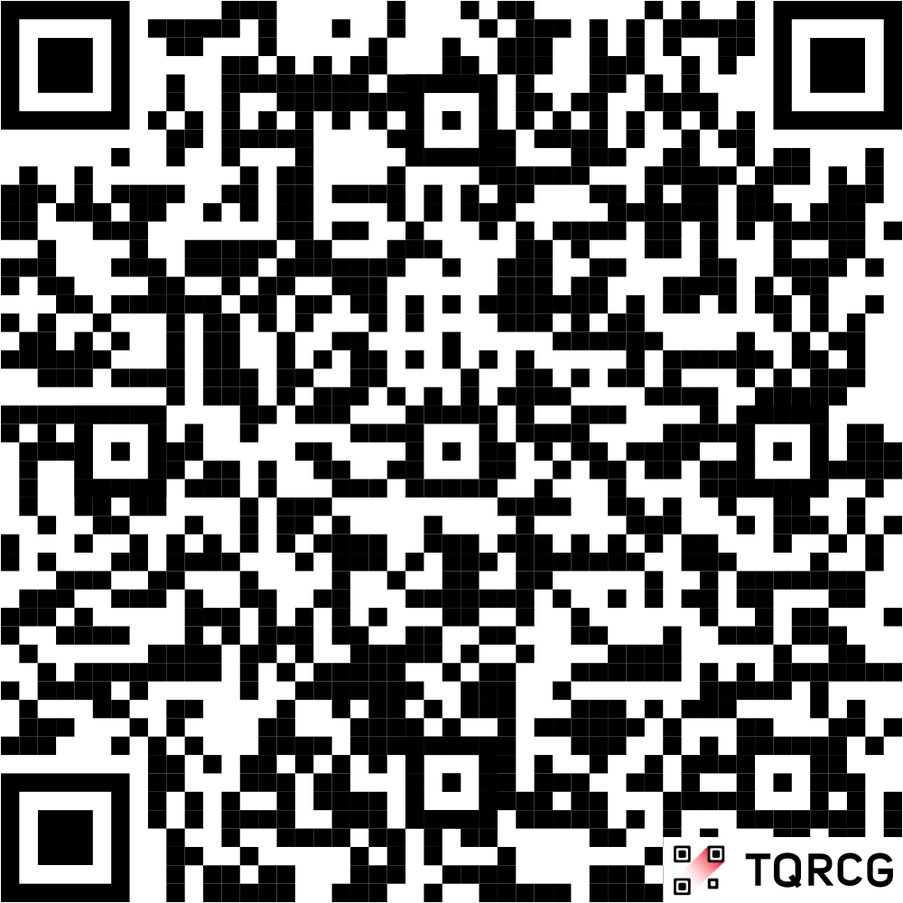
Area 5 Leadership Conference - Judges Event Sign-Up *Parents Only
Got any parents/guardians that would like to judge at the Area Leadership Conference?
Share the QR Code to any adult that would like to judge an event!
Notes:
amisha

Slide 12

DONATION DRIVE & CARDS
3 DONATIONS = 10 MEMBERSHIP POINTS
ITEMS:
Moisturizers and Lotion
Lip Balm
Tissues
Hand Sanitizer
New or Unused Journals
New or Good-Condition Books
CHICK-FIL-A GIFT CARD FOR TOP 3 DONATORS!
Notes:
prathmesh

Slide 13
CARD DRIVE
3 CARDS = 1 VOLUNTEER HOUR
REQUIREMENTS:
Short, uplifting message
Hand-made with effort
Colorful
CHICK-FIL-A GIFT CARD FOR TOP WRITER!
Notes:
emily

Slide 14
IMPORTANT DATES
Area Competition
Winter Social and Meeting
December 6th
In front of SLHS by 6:20 AM
December 11th
@ 6:45 in Room 2515
@ 2:45 in LGI
Notes:
anand

Slide 15
Stay Connected!
Remind:
Insta:
Email:
@7lakesfbla
“slhsfbla26” to 81010
sevenlakes fbla@gmail.com
Area Competition Remind:
“slhsfblaac”
Notes:
rosie

Slide 16
THANK YOU!
Be sure to have your ID scanned in for official attendance
with Mrs. Abel
in the back.
Notes:
kamsi

