Slide 1








October Meeting
October 7th, 2025
Notes:
noah + claire

Slide 2
FBla pledge
I solemnly promise to uphold the aims and responsibilities of Future Business Leaders of America and, as an active member I shall strive to develop the qualities necessary in becoming a responsible business leader.
Notes:
pranava

Slide 3
FRESHMAN AMBASSADORS
MEET YOUR FRESHMAN AMBASSADORS FOR 25-26!
Elizabeth hu
varnika pamarty
Akshita raj
Gary shen
Notes:
noah

Slide 4
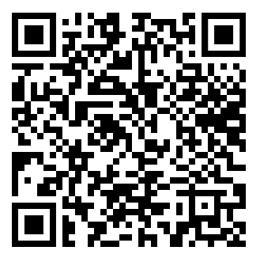
membership signups
01
02
03
Membership due Oct 10th!
Membership google form
$50 Pay n’ go fee
Code of Conduct Consent to treatment
CTSO Form
←Are you a member yet??
Notes:
rosie

Slide 5

DONATION DRIVE
Week 1, OCtober 6th-9th:
Lip balms, vaseline, lotion, and moisturizers
Week 2, October 14th-17th:
Tissues and hand sanitizer
Week 3, October 20th-24th:
Books (new or used)
Week 4, october 27th-30th:
Journals (New only)
3 CHICK-FIL-A Gift cards for top donors
1o points for 3 items DONATED
DROP OFF @ Room 2516 after school
Notes:
prathmesh and emily

Slide 6
Card DRIVE
From october 6th to 30th:
3 cards for houston methodist hospital =
1 volunteer hour
CHICK-FIL-A Gift card for top Writer
*DROP OFF @ Room 2516 after school
Card Requirements:
hand-made
Appropriate Design with effort
Short, uplifting message
For doctors, patients, and staff
\
* Max of 9 Cards for up to 3 Hours
Notes:
prathmesh and emily

Slide 7


Halloween Social
Thursday, October 30th @ 2:45 pm in lgi
Food, Games, & PRizes
More details will be sent out on remind so stay updated!
Notes:
vanshika

Slide 8
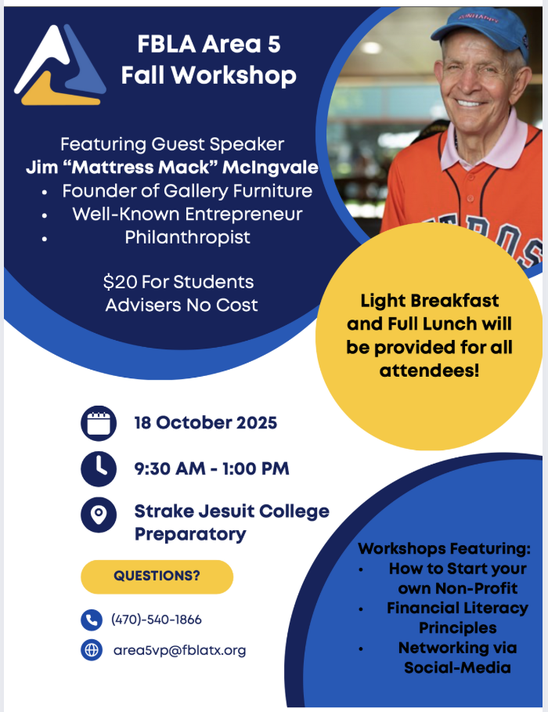
Fall Workshop
Saturday, October 18th @ Strake Jesuit
REMIND FOR FALL WORKSHOP:
“slhsfblafw”
Notes:
amisha (mention must be in remind if you’re attending fall workshop)

Slide 9
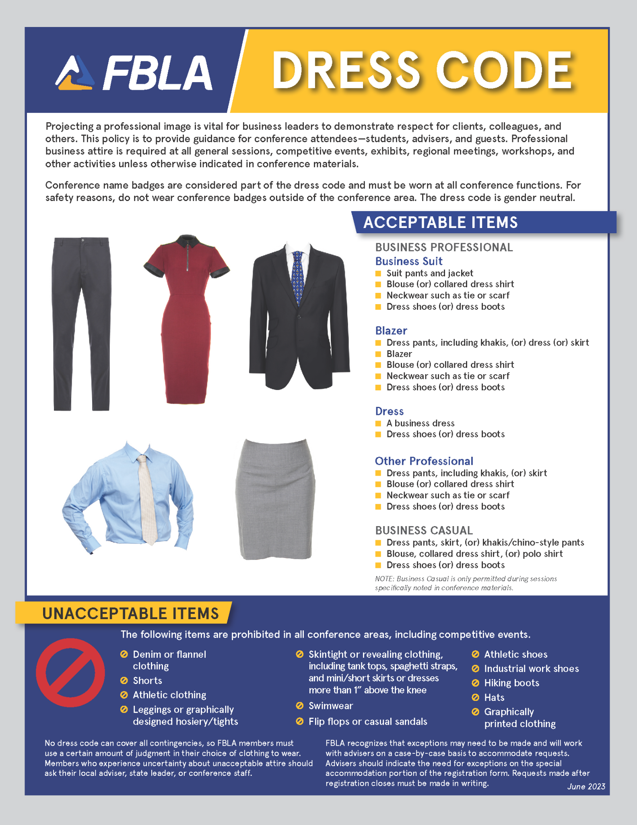
Fall Workshop
DRESS CODE
Professional Business Attire is REQUIRED for Fall Workshop, Conferences, and Competitions
The Professional Dress Code can be found on the FBLA National Website
Notes:
emily

Slide 10
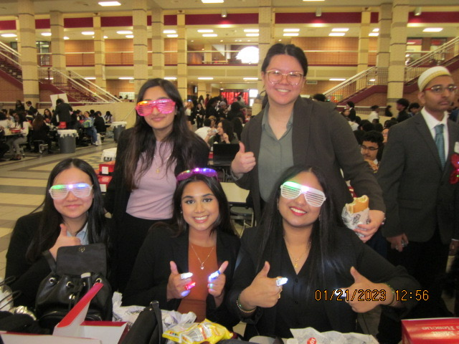
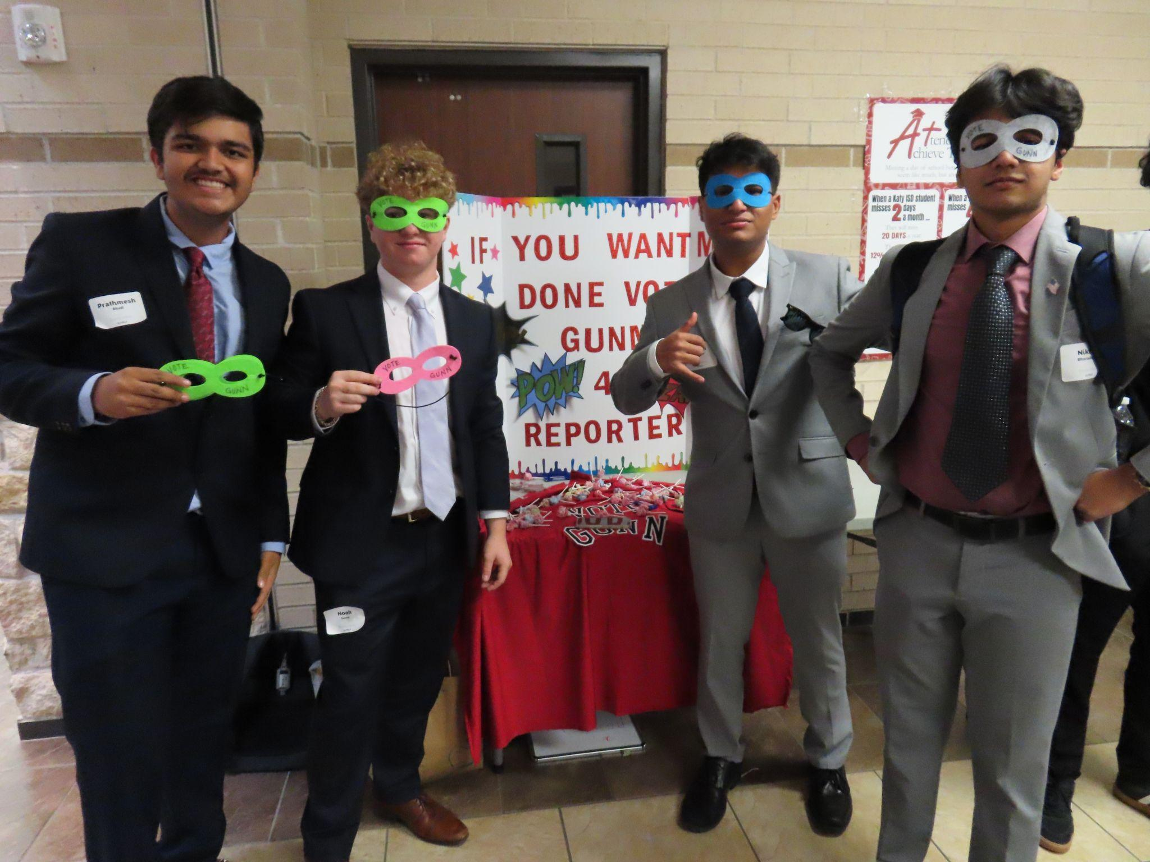
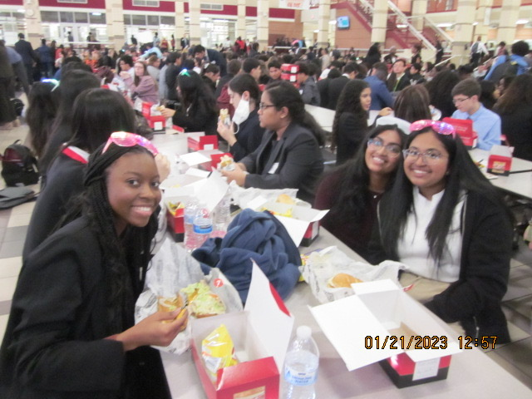
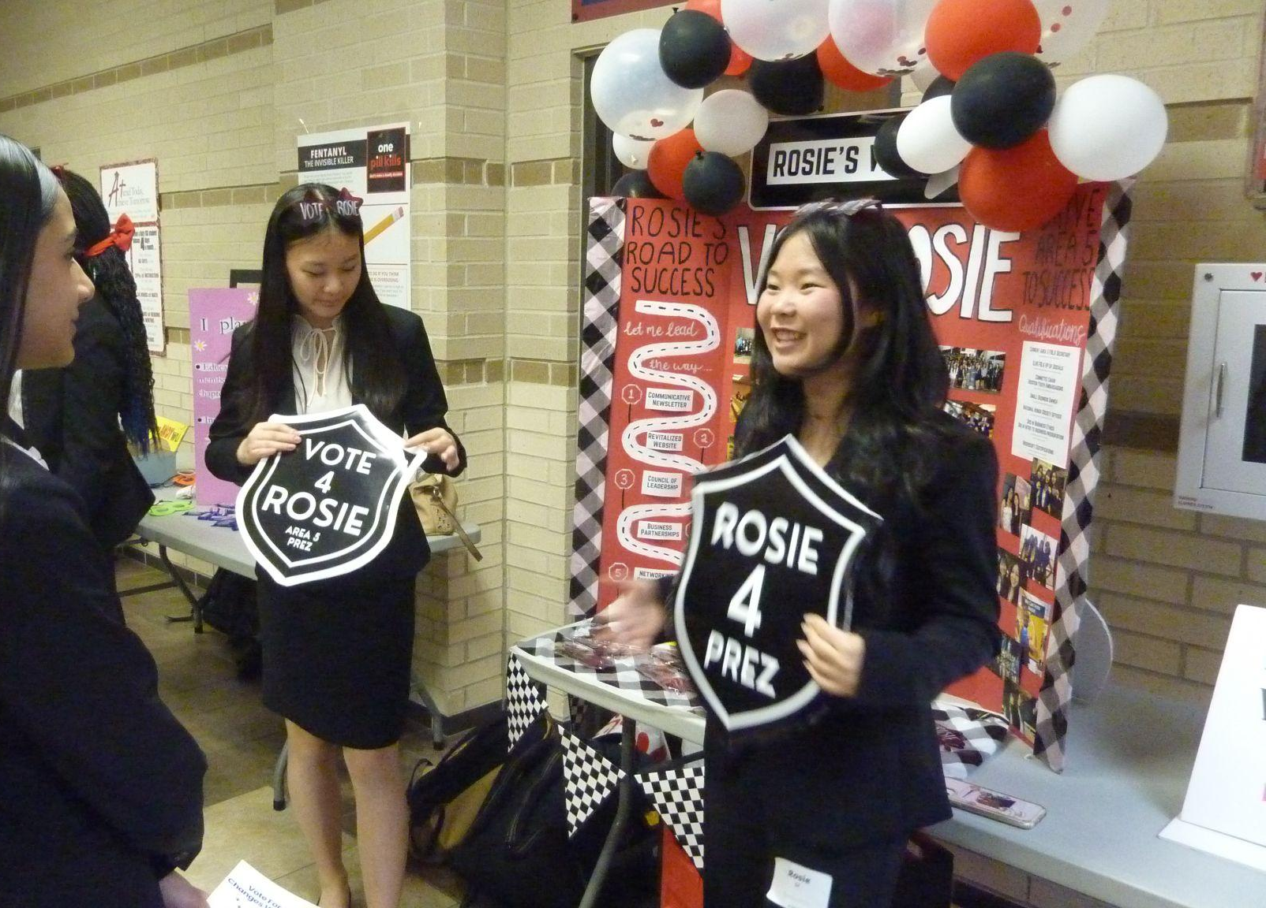
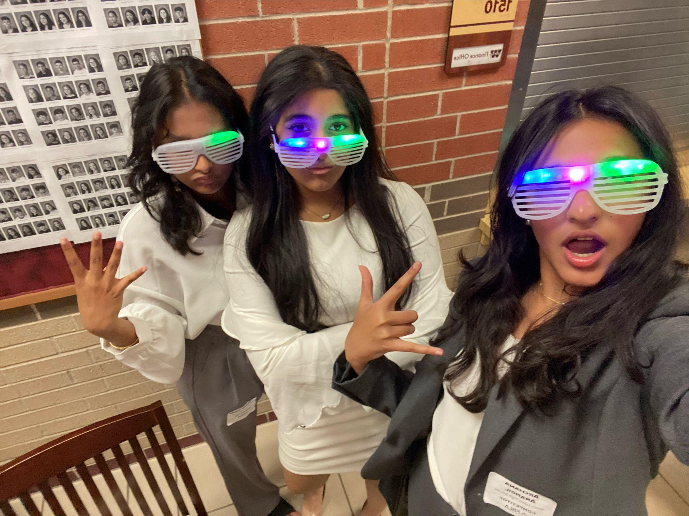
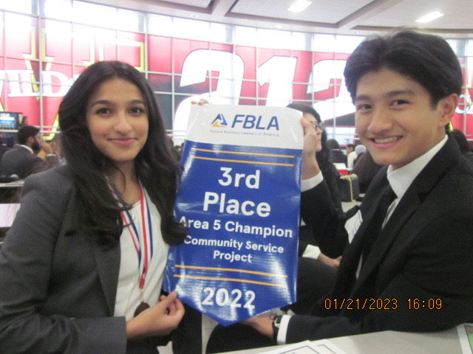
Area Leadership Conference
Notes:
claire

Slide 11
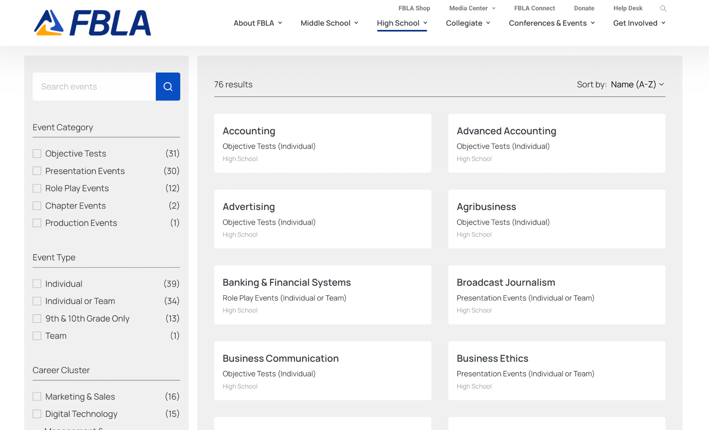
Competitive events
Area Leadership Conference is
Dec 6th at Mayde Creek High School
Explore the Competitive Events on the FBLA Website!
Notes:
anand (mention that the qr code on the handout links to all the events)

Slide 12
Testing Events
Test components:
Objective Test Only Events are INDIVIDUAL ONLY (No Teams)
Role Play Events w/ Tests can consists of Individuals or Teams of 2-3
Objective Testing: A 60-minute test over the specified event topic
Production and Objective Testing:
Two parts: a production test administered and proctored at a designated school and a 60-minute objective test administered onsite. Competitors must complete both parts for award eligibility.
Collaborative/ Individual Objective Testing and Role Play:
A 60-minute objective test will be administered at the competition. Team competitors
will take one objective test collaboratively or individually depending on event.
Notes:
Vig (don’t say the stuff on the slides, just say please reference the handouts for info) (talk about personal experience with test event)

Slide 13
Prejudged Report and Presentation:
Report content is prejudged before the conference. The presentation of the report is judged during the conference.
Prejudged Project and Presentation:
Project content is prejudged before the conference. The presentation of the project is judged during the conference.
Demonstration: The demonstration of a project on a specific topic provided in the event guidelines. Competitors may use technology, equipment, and/or visual aids as part of the presentation.
Interview: The employer (judge) interviews the applicant (competitor) by asking typical job interview questions.
Speech: A business speech based on FBLA-PBL goals, current events, and/or relevant business topics created and articulated by competitors.
Presentation Events
(Teams: 3 people max for Role Play & Presentation Events)
Role play: Competitors receive a role play scenario 10 or 20 minutes prior to their scheduled event times. Judges receive a copy of the role play along with suggested questions to ask during each performance (role play).
Notes:
Sana (dont say the stuff on the slides, tell them the info is on the handout) (talk about personal experience with pres event)

Slide 14
Area Leadership Conference
Event signups are starting OCT 21st!
Sign-up dates:
  Oct 21st: Officers & members who competed at NLC ‘25
  Oct 22nd: Members currently in a business course
  Oct 23rd: All other members
Before/After School in RM 2513 (Mr. Saunders)
MUST have at least 20 member points to sign up
Think of at least 3 potential events you’re interested in
  Events fill up quick! Make sure you have backups!
Notes:
claire

Slide 15
Important Dates
Fall workshop
  october 18th @ strake jesuit
Area Competition Registration
    October 21st - 23rd (Room 2513)
Halloween Social
    october 30th @ 2:45 (LGI)
november meeting
    november 4th @ 2:45 (LGI)
Notes:
noah

Slide 16
Stay connected
Remind: text “slhsfbla26” to 81010
Website: https://sevenlakesfbla.wixsite.com/slhsfbla
Instagram: @7lakesfbla
email: sevenlakesfbla@gmail.com
Notes:
prathmesh

Slide 17
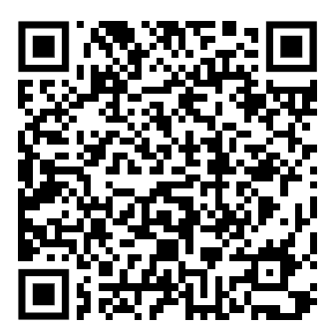
Scan for Attendance!
Thank you!
Any questions?
Notes:
rosie

