Slide 1
SEVEN LAKES HIGH SCHOOL FUTURE BUSINESS LEADERS OF AMERICA
Informational Meeting | August 26th
Notes:
Claire + Noah

Slide 2
Meet the Officers!
Co-Presidents- Noah Gunn & Claire Simoens
Executive VP- Rosie Li
VP of Membership- Amisha Agrawal
VPs of Community Service and Fundraising- Prathmesh Bhatt & Emily Ma
VPs of Socials- Pranava Mallapragada & Vanshika Mehta
Reporter & Historian- Sana Batchu & Titilayo Oduwole
Systems Admin- Kamsi Adebiyi
Secretary- Anand Vakharia
Treasurer- Vignesh Hamsagadda
State Reporter & Historian- Taylor Yu
Area 5 President- Rosie Li
Notes:
individual intros

Slide 3

What is FBLA?
Student Run Business Education Organization
Workshops, Conferences, Competitions
Developing leadership and shaping the next generation
Notes:
Rosie

Slide 4
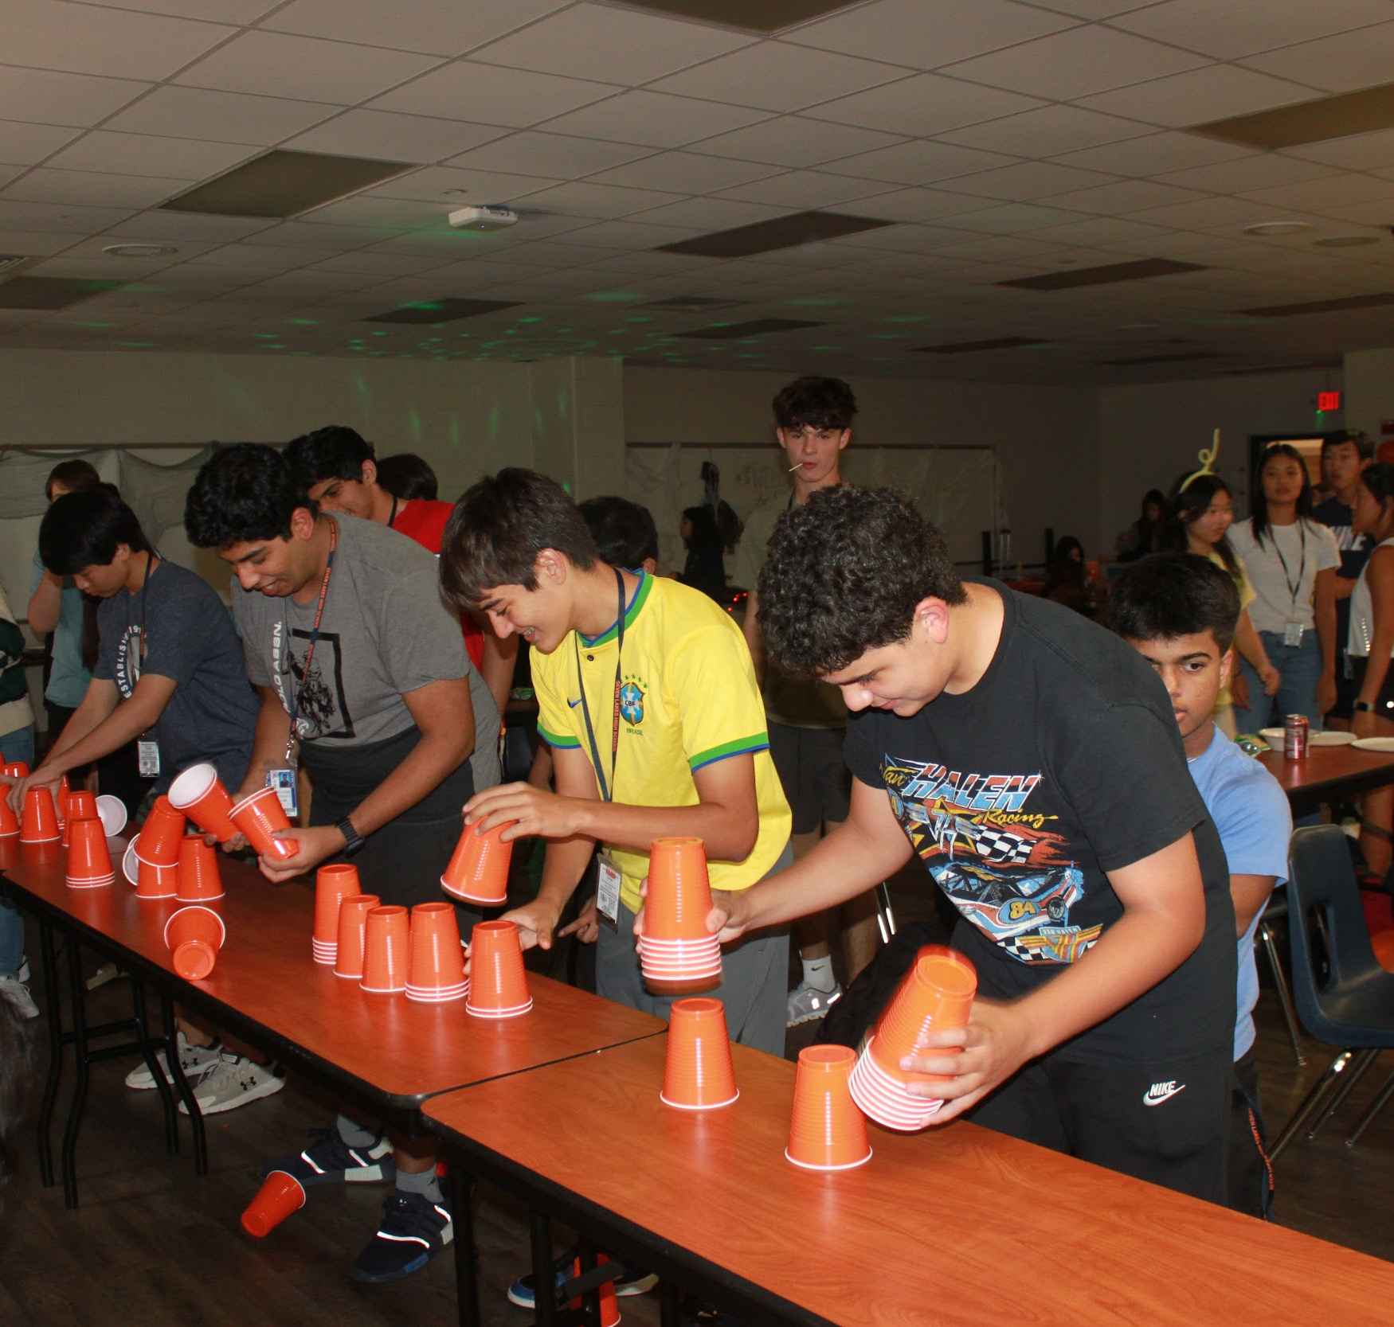
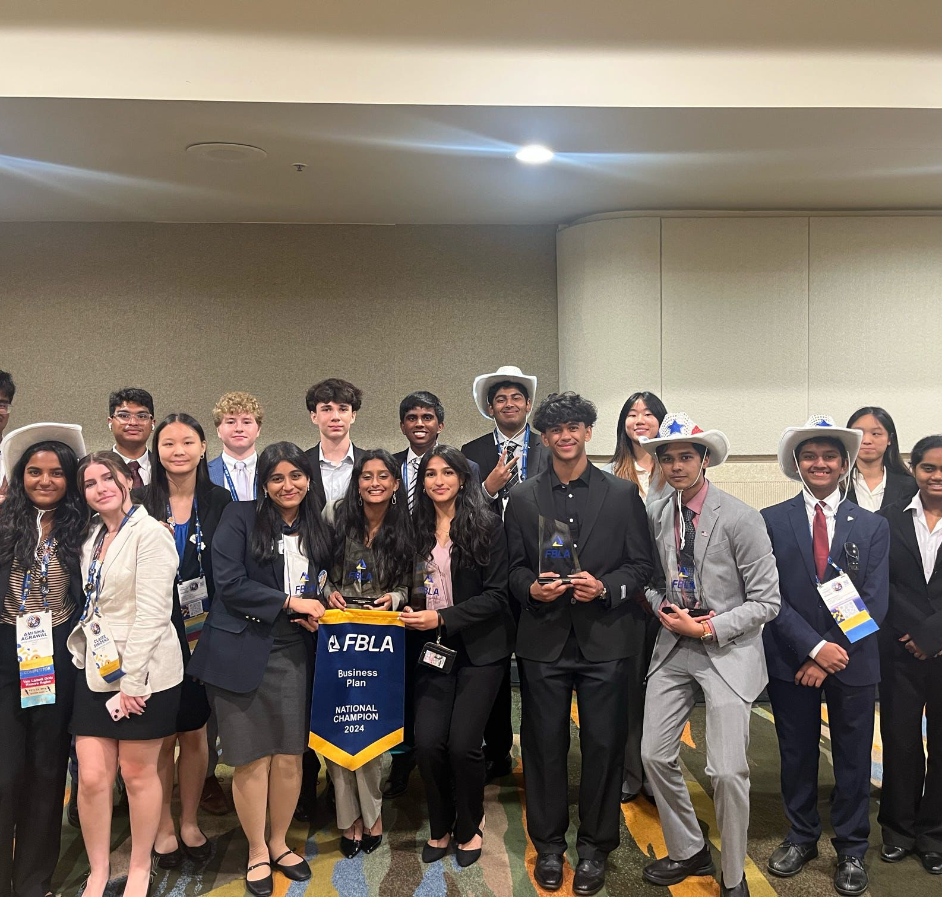
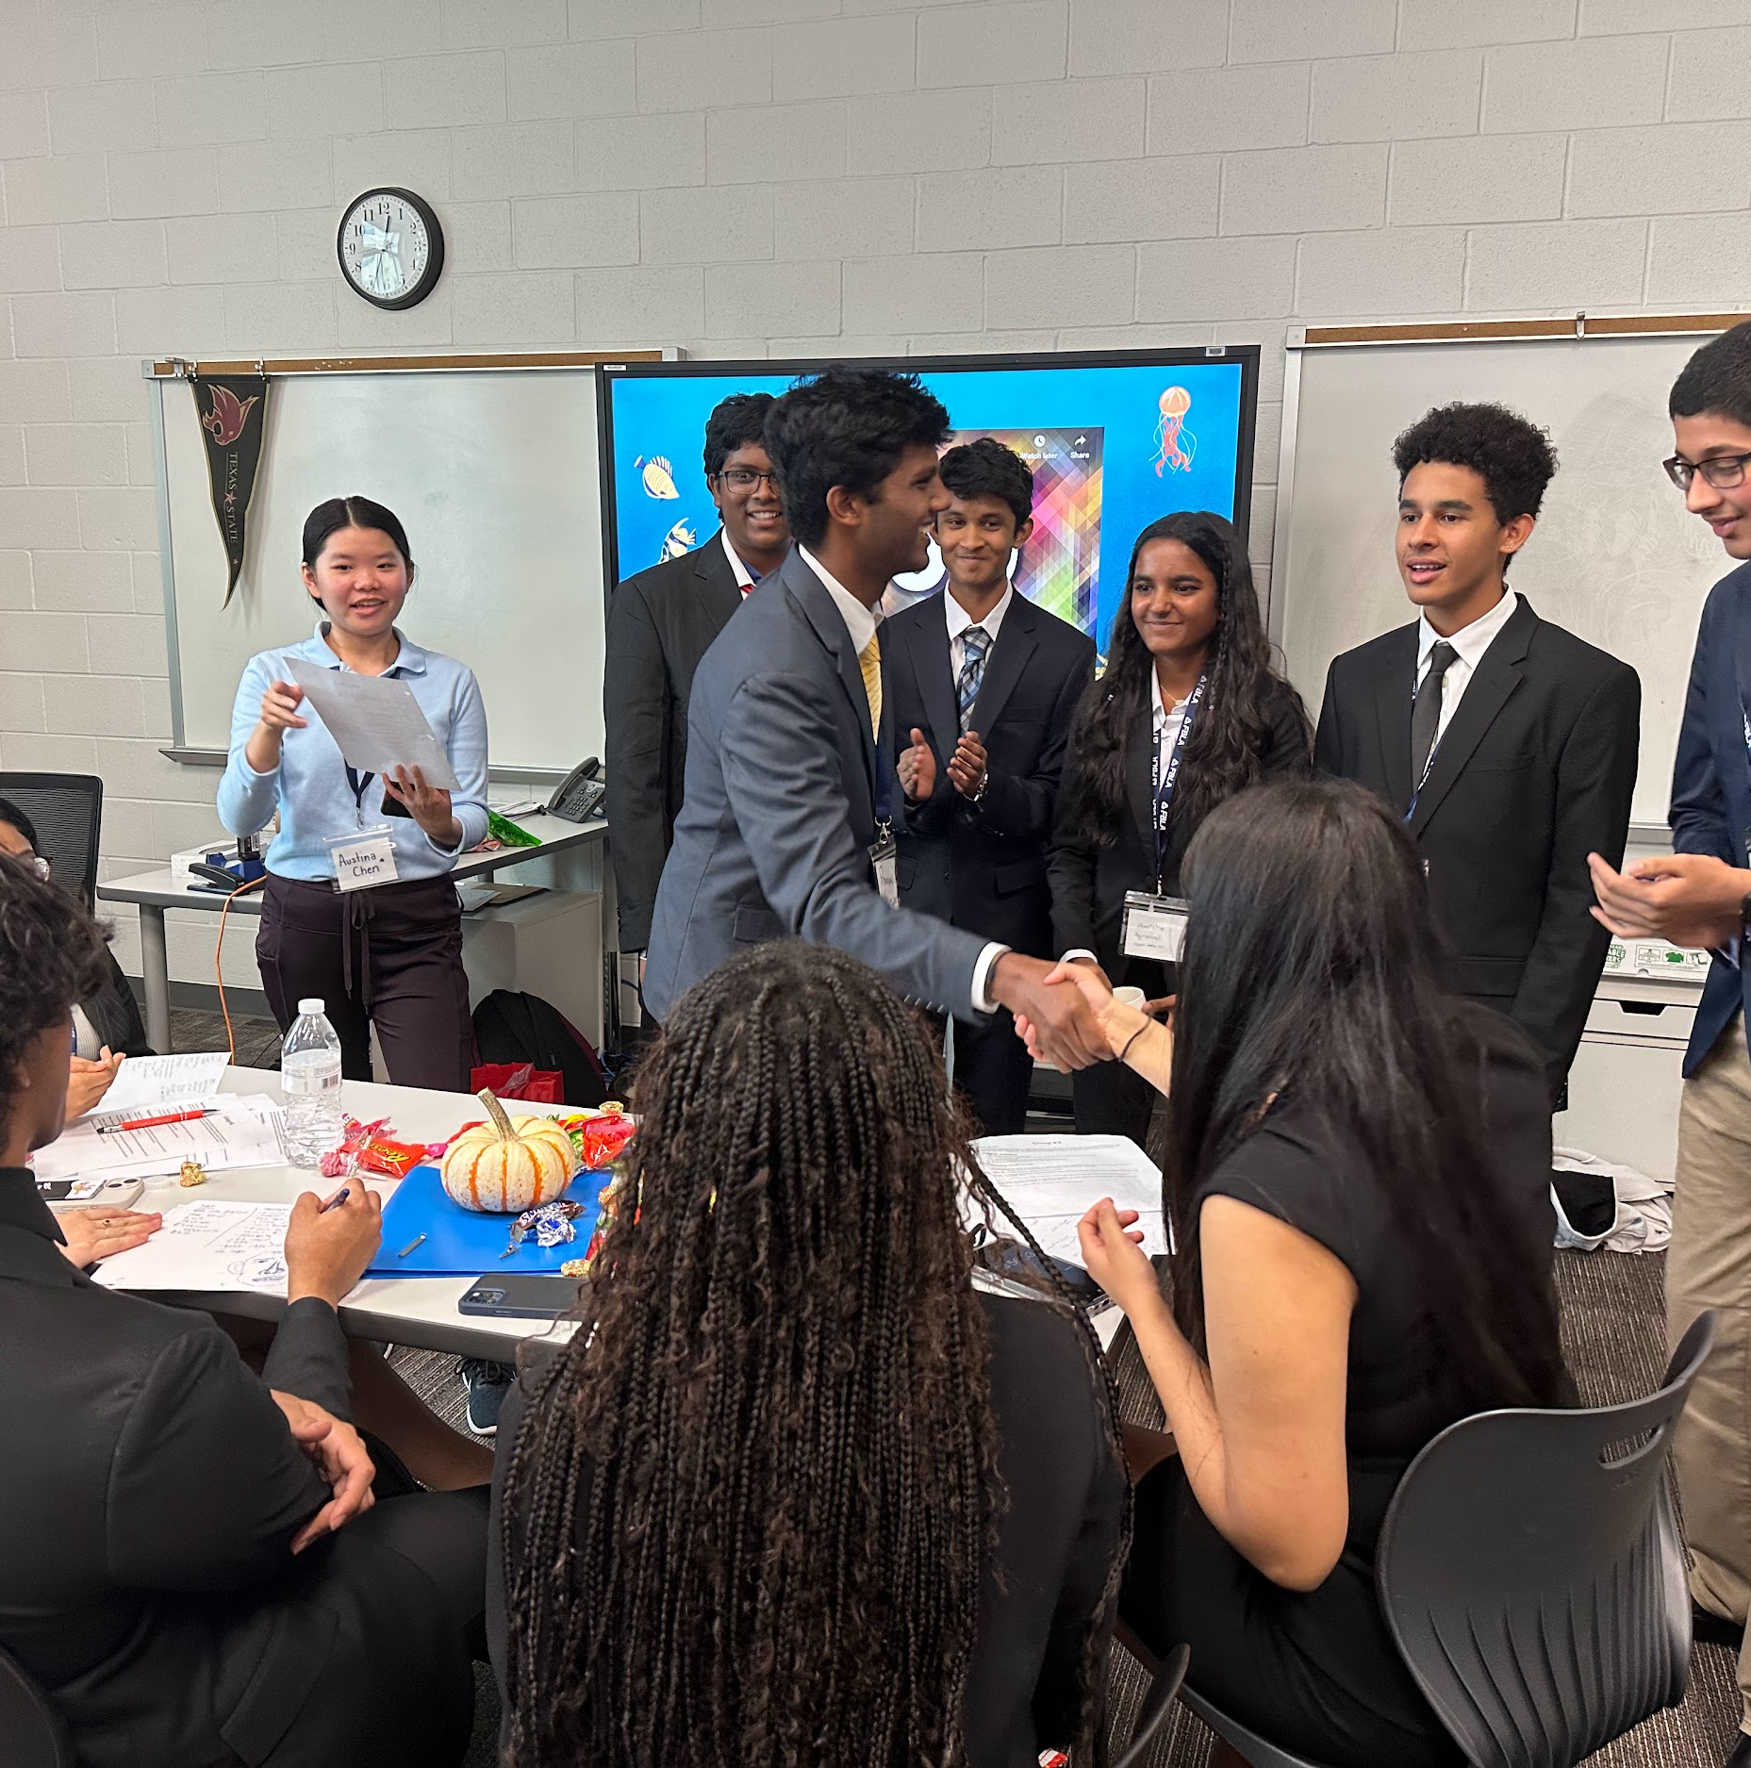
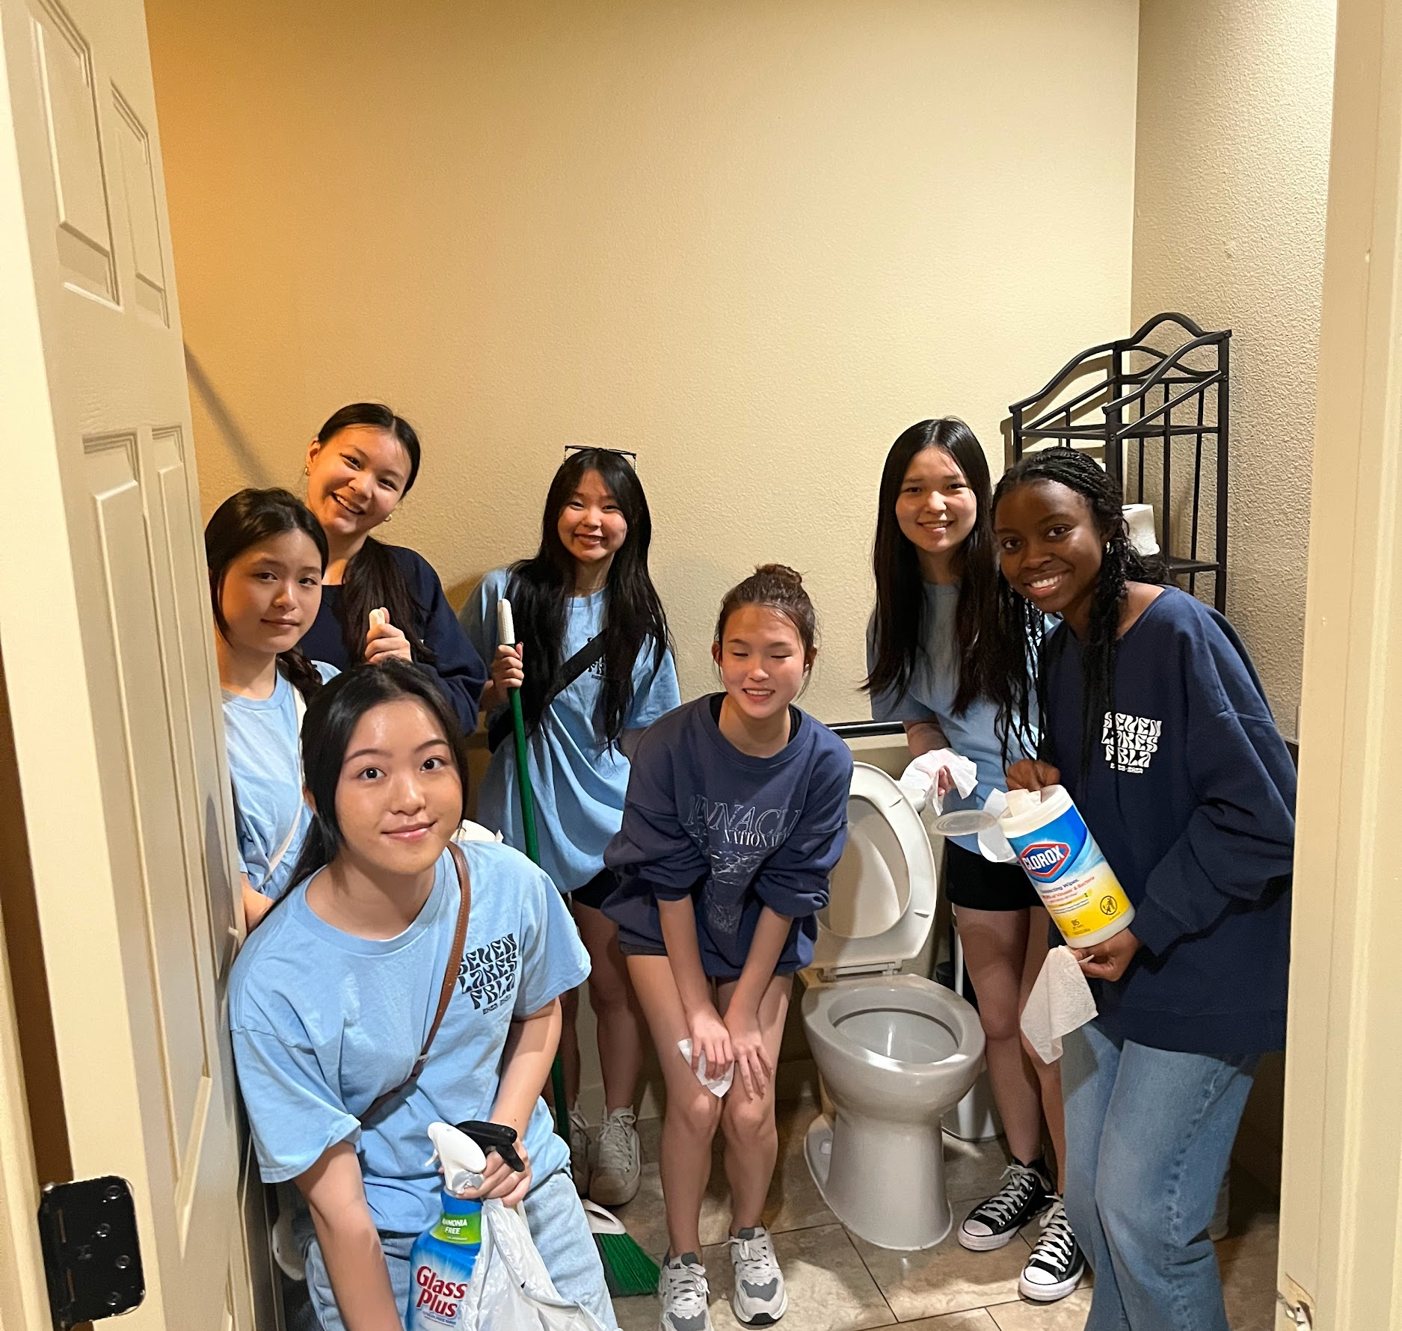
What do we do?
Competitions
Socials
FBLA offers over 70 different speaking, testing, and presentation events at the area, state, and national level
Our chapter offers many opportunities to network and make new friends through a variety of socials
Community Service
Workshops
We give back to our community and give our members opportunities to receive volunteer hours
We attend the annual Area V Fall Workshop, in which dynamic speakers host seminars and activities for FBLA members
Notes:
Emily

Slide 5
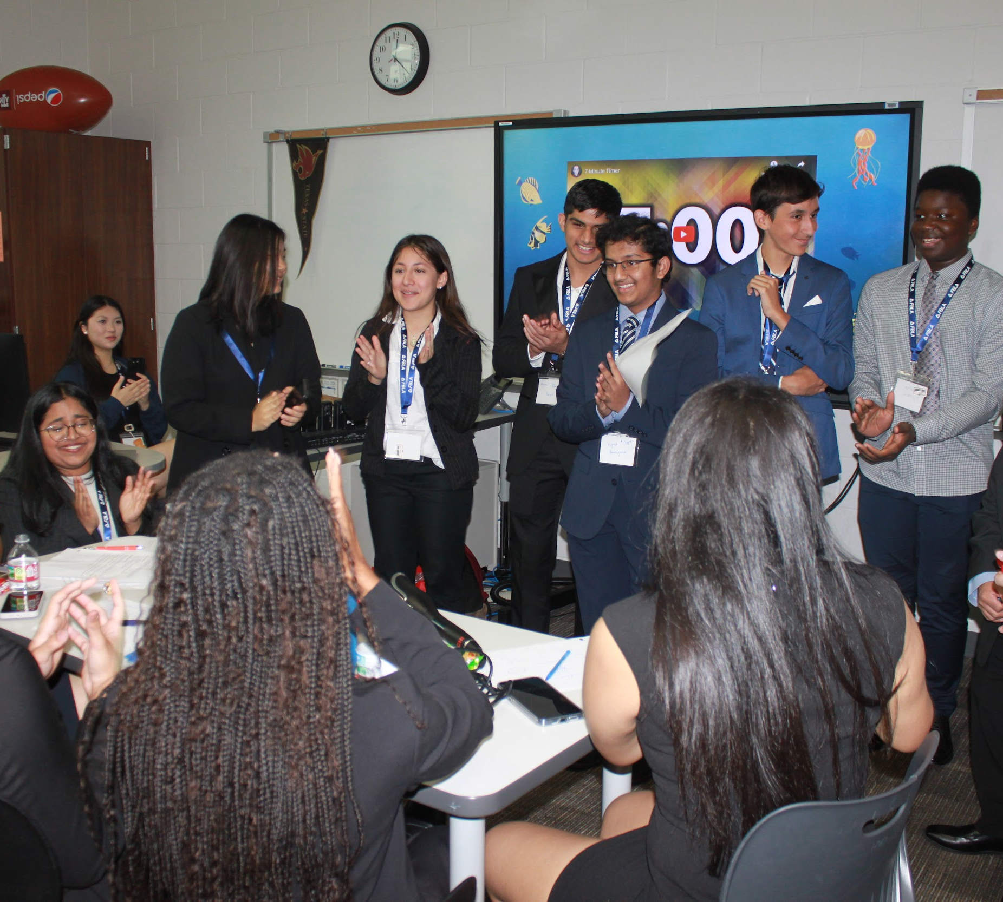
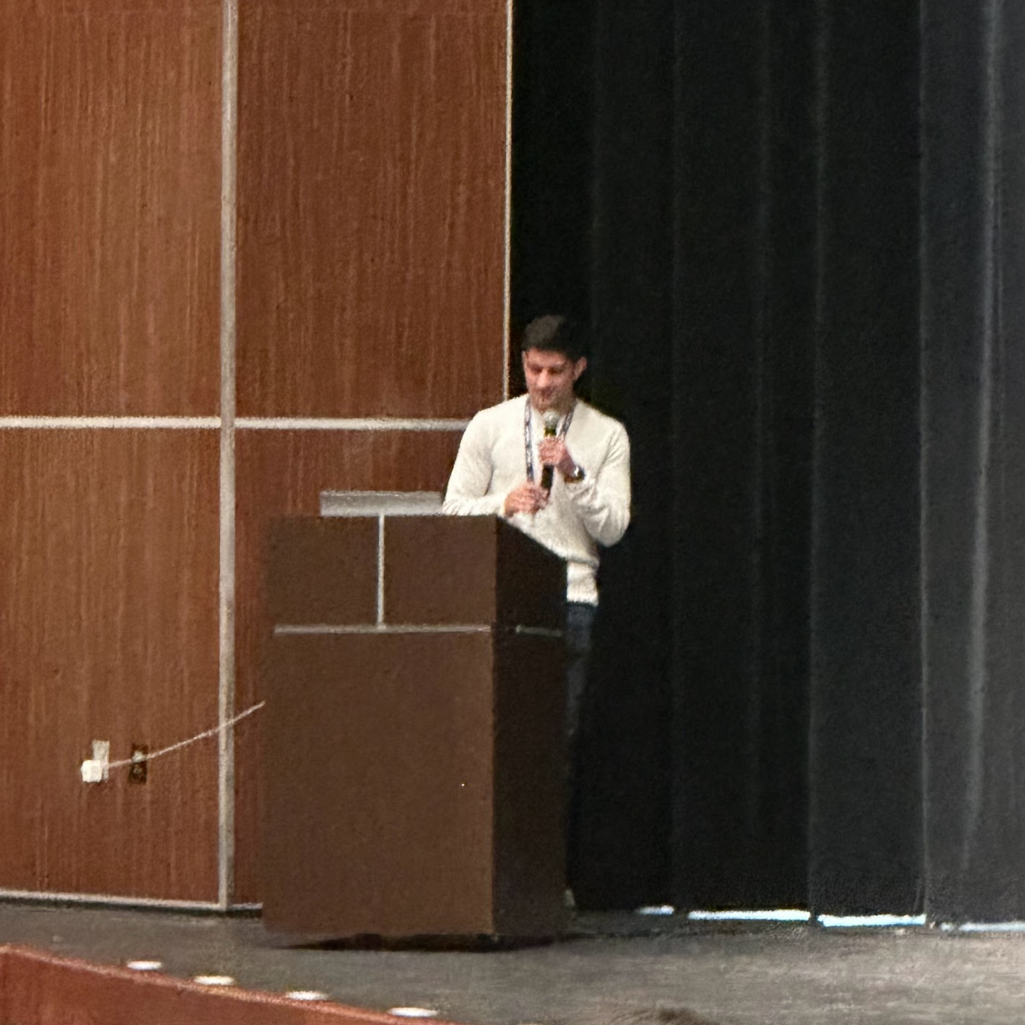
Covers various business skills and scenarios
Dynamic speakers
Interactive presentations
Qualified business professionals
Workshops
Notes:
Prathmesh

Slide 6
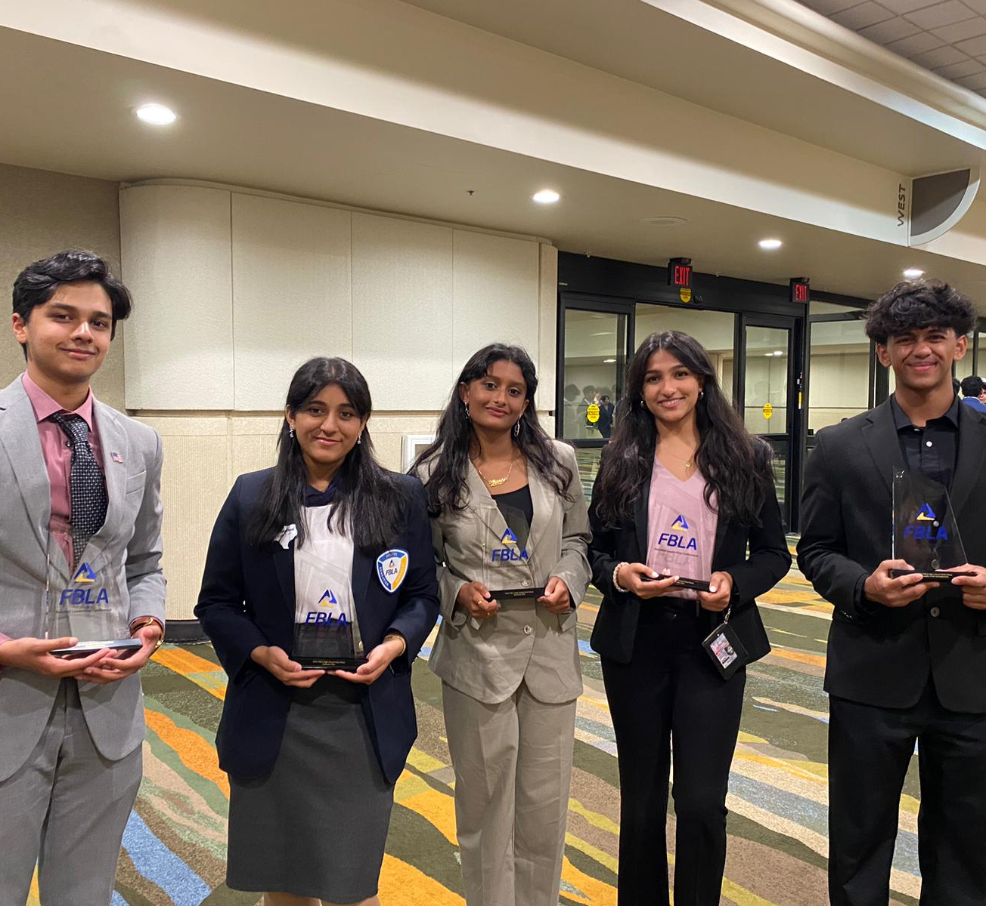
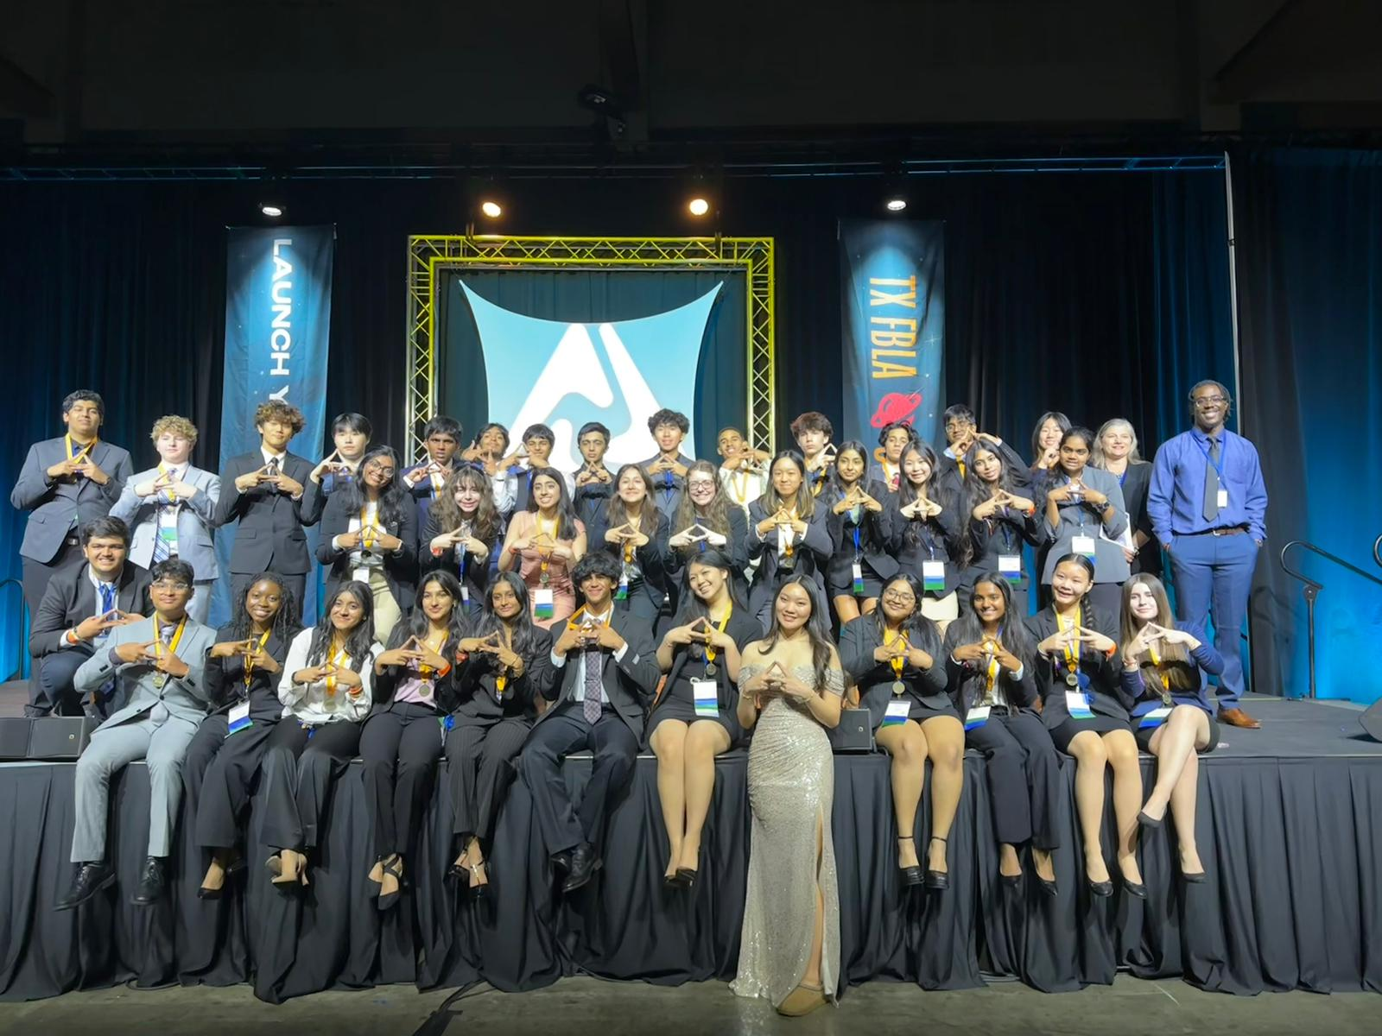
Competitions
Three levels: Area, State, and Nationals
76 different competition events:
  Presentation, testing, or both
  Caters to a wide variety of interests, from Graphic Design to Sports and Entertainment Management
  Prepares you for the professional world
Notes:
Amisha

Slide 7
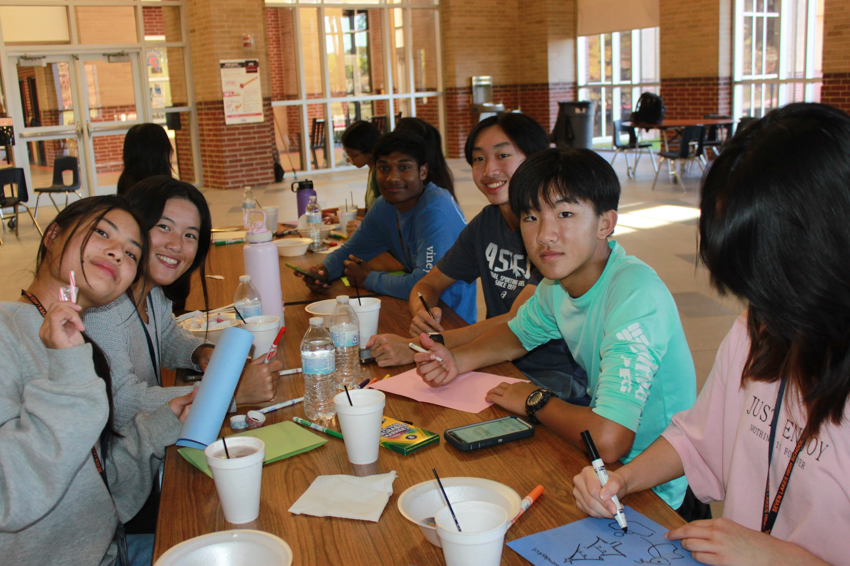
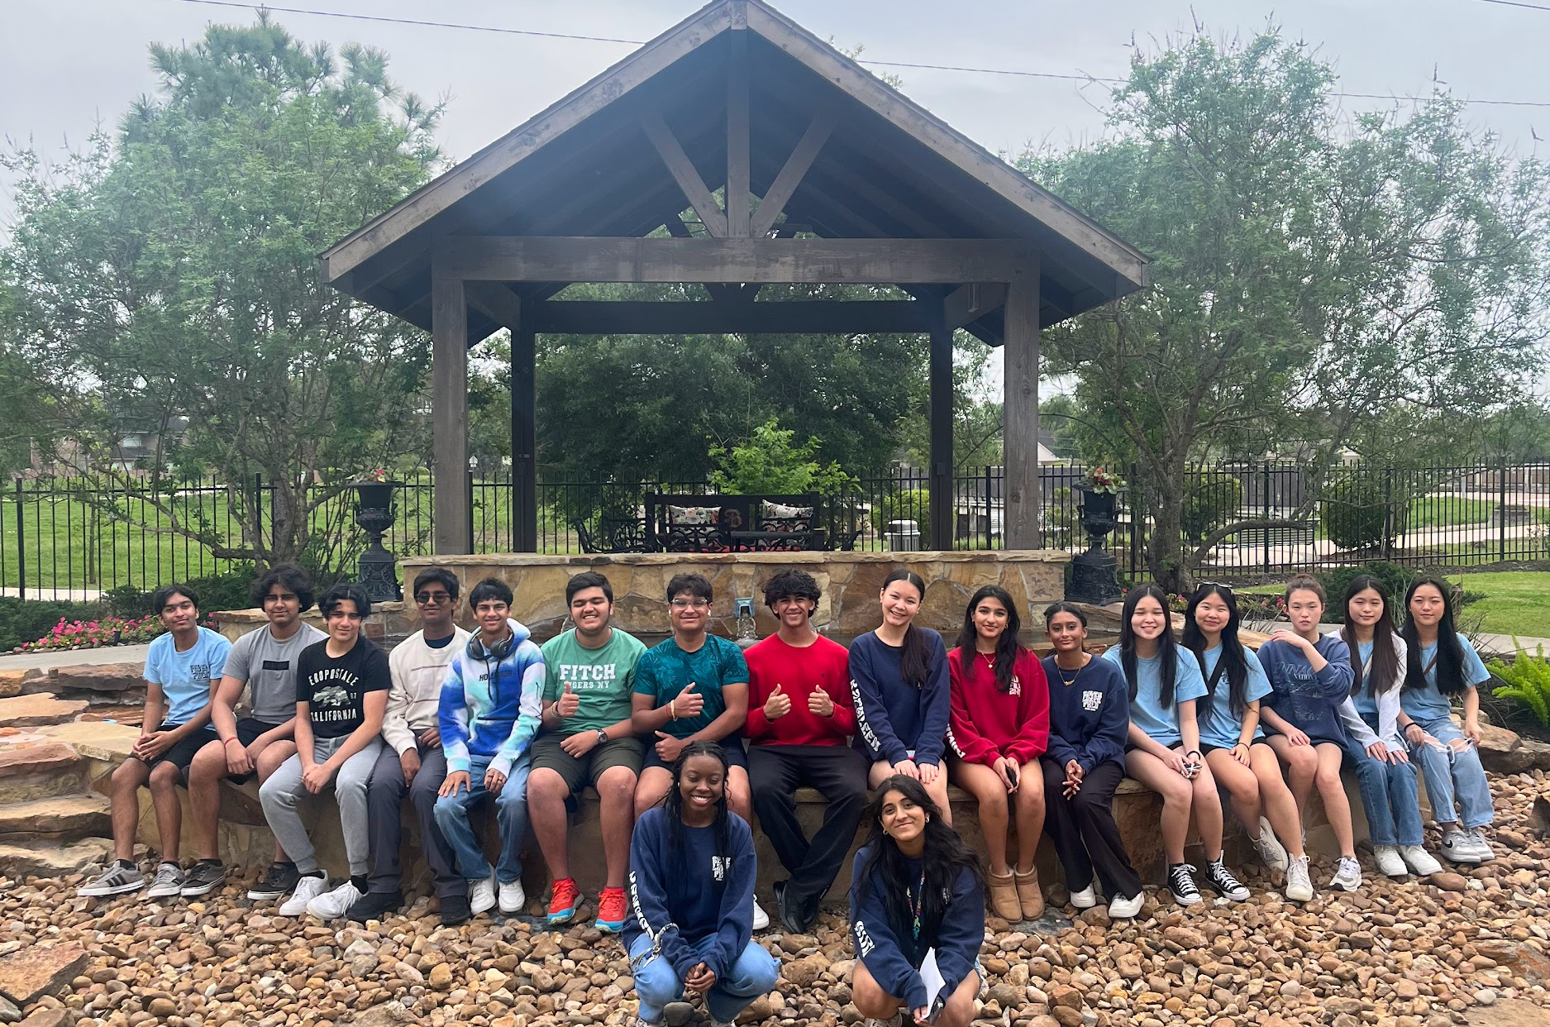
Community Service
Earn community service hours for NHS and SOS!
Notes:
Sana

Slide 8
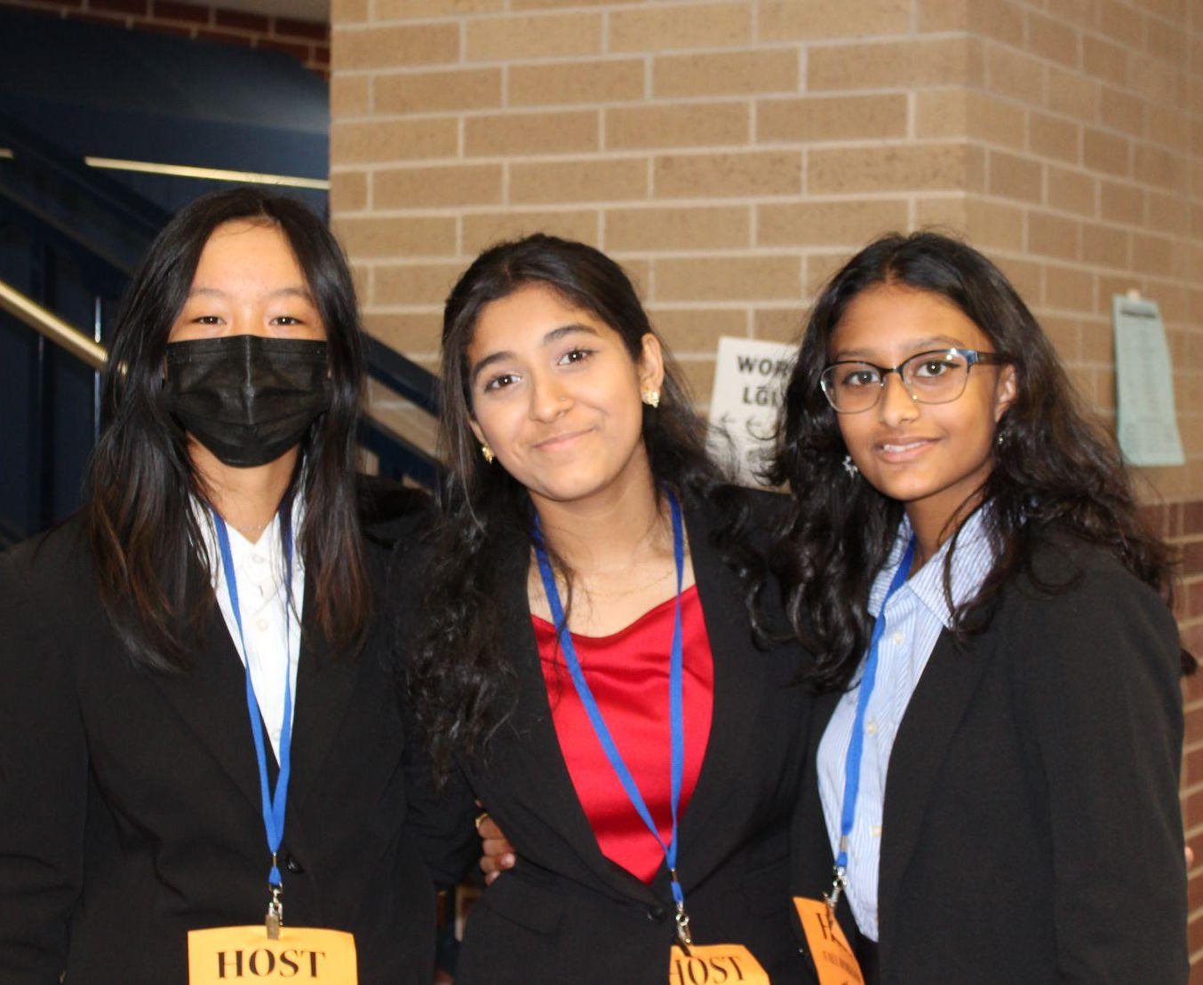
Opportunities for Freshmen!
Freshmen Ambassadors: We are looking for freshmen to join our officer team!
More information will be given out at our next meeting
Applications open 9/2 and
close 9/19
Notes:
Claire

Slide 9
Point Requirements
In order to participate in Area, State, and Banquet, you must meet a point requirement every few months to maintain Active Member Status
***20 points by end of October to sign up for Area
Meetings, 10 points
Socials, 10 points
Volunteering, 20 points
Workshops, 30 points
*Check your points on the FBLA website!
Notes:
Vanshika

Slide 10
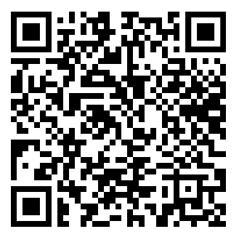
How to Join
1
All info sent out on Remind!
@slhsfbla26
Fill out the Membership Info Google form.
Turn in Permission Forms to the business hallway
Pay the $50 fee through Pay N’ Go.
2
3
Notes:
Pranava

Slide 11
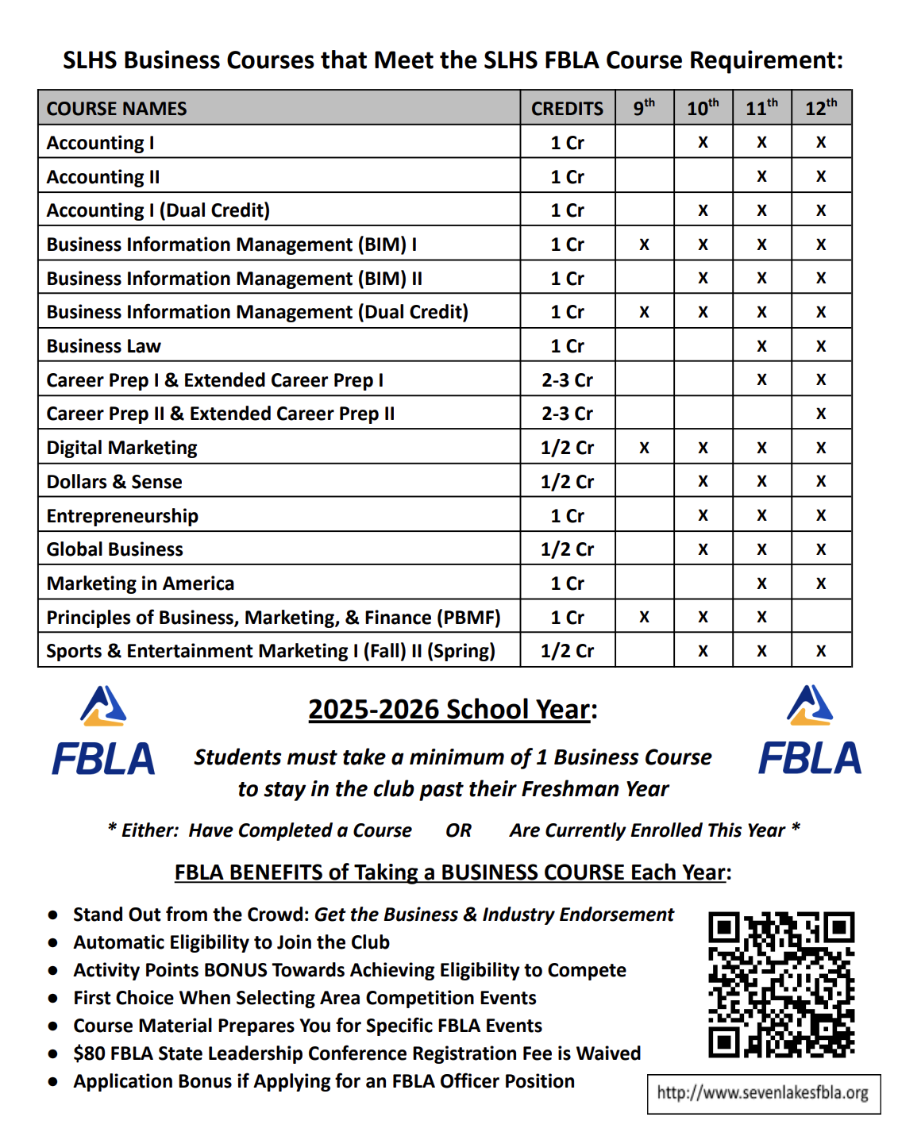
Business class requirement
FBLA members in grades 10-12 are REQUIRED to be in OR have taken one of these business classes. Freshmen are NOT required to be in a business class to join.
Notes:
Vig

Slide 12
First Official Meeting
Our first official meeting will be on:
September 2nd, 2024
6:50 AM in RM 2513
OR
2:45 PM in the LGI
Notes:
Anand

Slide 13


Game Time!
Everyone stand up and walk around the LGI
Have someone who matches the description in the box to sign your paper
*Only ONE signature per person on each paper
First 5 people to get 5 in a row and come to the front get a prize!
Notes:
Noah

Slide 14
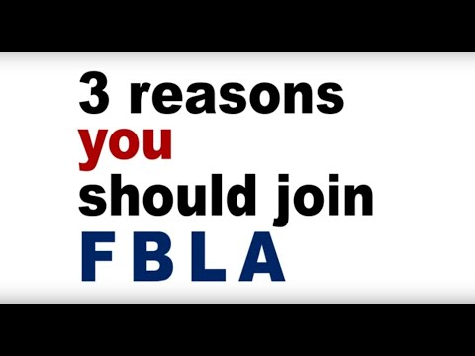
Notes:
saunders

Slide 15

Notes:
saunders

Slide 16




STAY CONNECTED!
Remind: Text @slhsfbla26 to 81010 or use the code in the remind app!
Instagram: Follow us @7lakesfbla
Facebook: Join group Seven Lakes High School FBLA
Website: http://tinyurl.com/slhsfbla
- bookmark it!
Notes:
Pranava

Slide 17
THANK YOU FOR COMING!
Any questions?
Notes:
Claire and Noah

